Slide 1

Child Care In Erie County
Kimberly Suminski
C.E.O. Child Care Resource Network (CCRN)

Slide 2

Child care data
Children who have access to high quality child care are more likely to graduate from high-school and college.
Children who have access to high quality child care are less likely to:
  Receive a special education placement
  Be held back a grade in elementary & high-school
  Be incarcerated
  Need public assistance later in life
The average cost for 52 weeks of infant care in New York State is over $15,000
Comparably in state SUNY college tuition is only $7,070
64% of New York State is considered a child care desert
  A child care desert is any census tract with more than 50 children under age 5 that contains either no child care providers or so few options that there are more than three times as many children as licensed child care slots.
Over 50% of Erie County is considered a child care desert

Slide 3
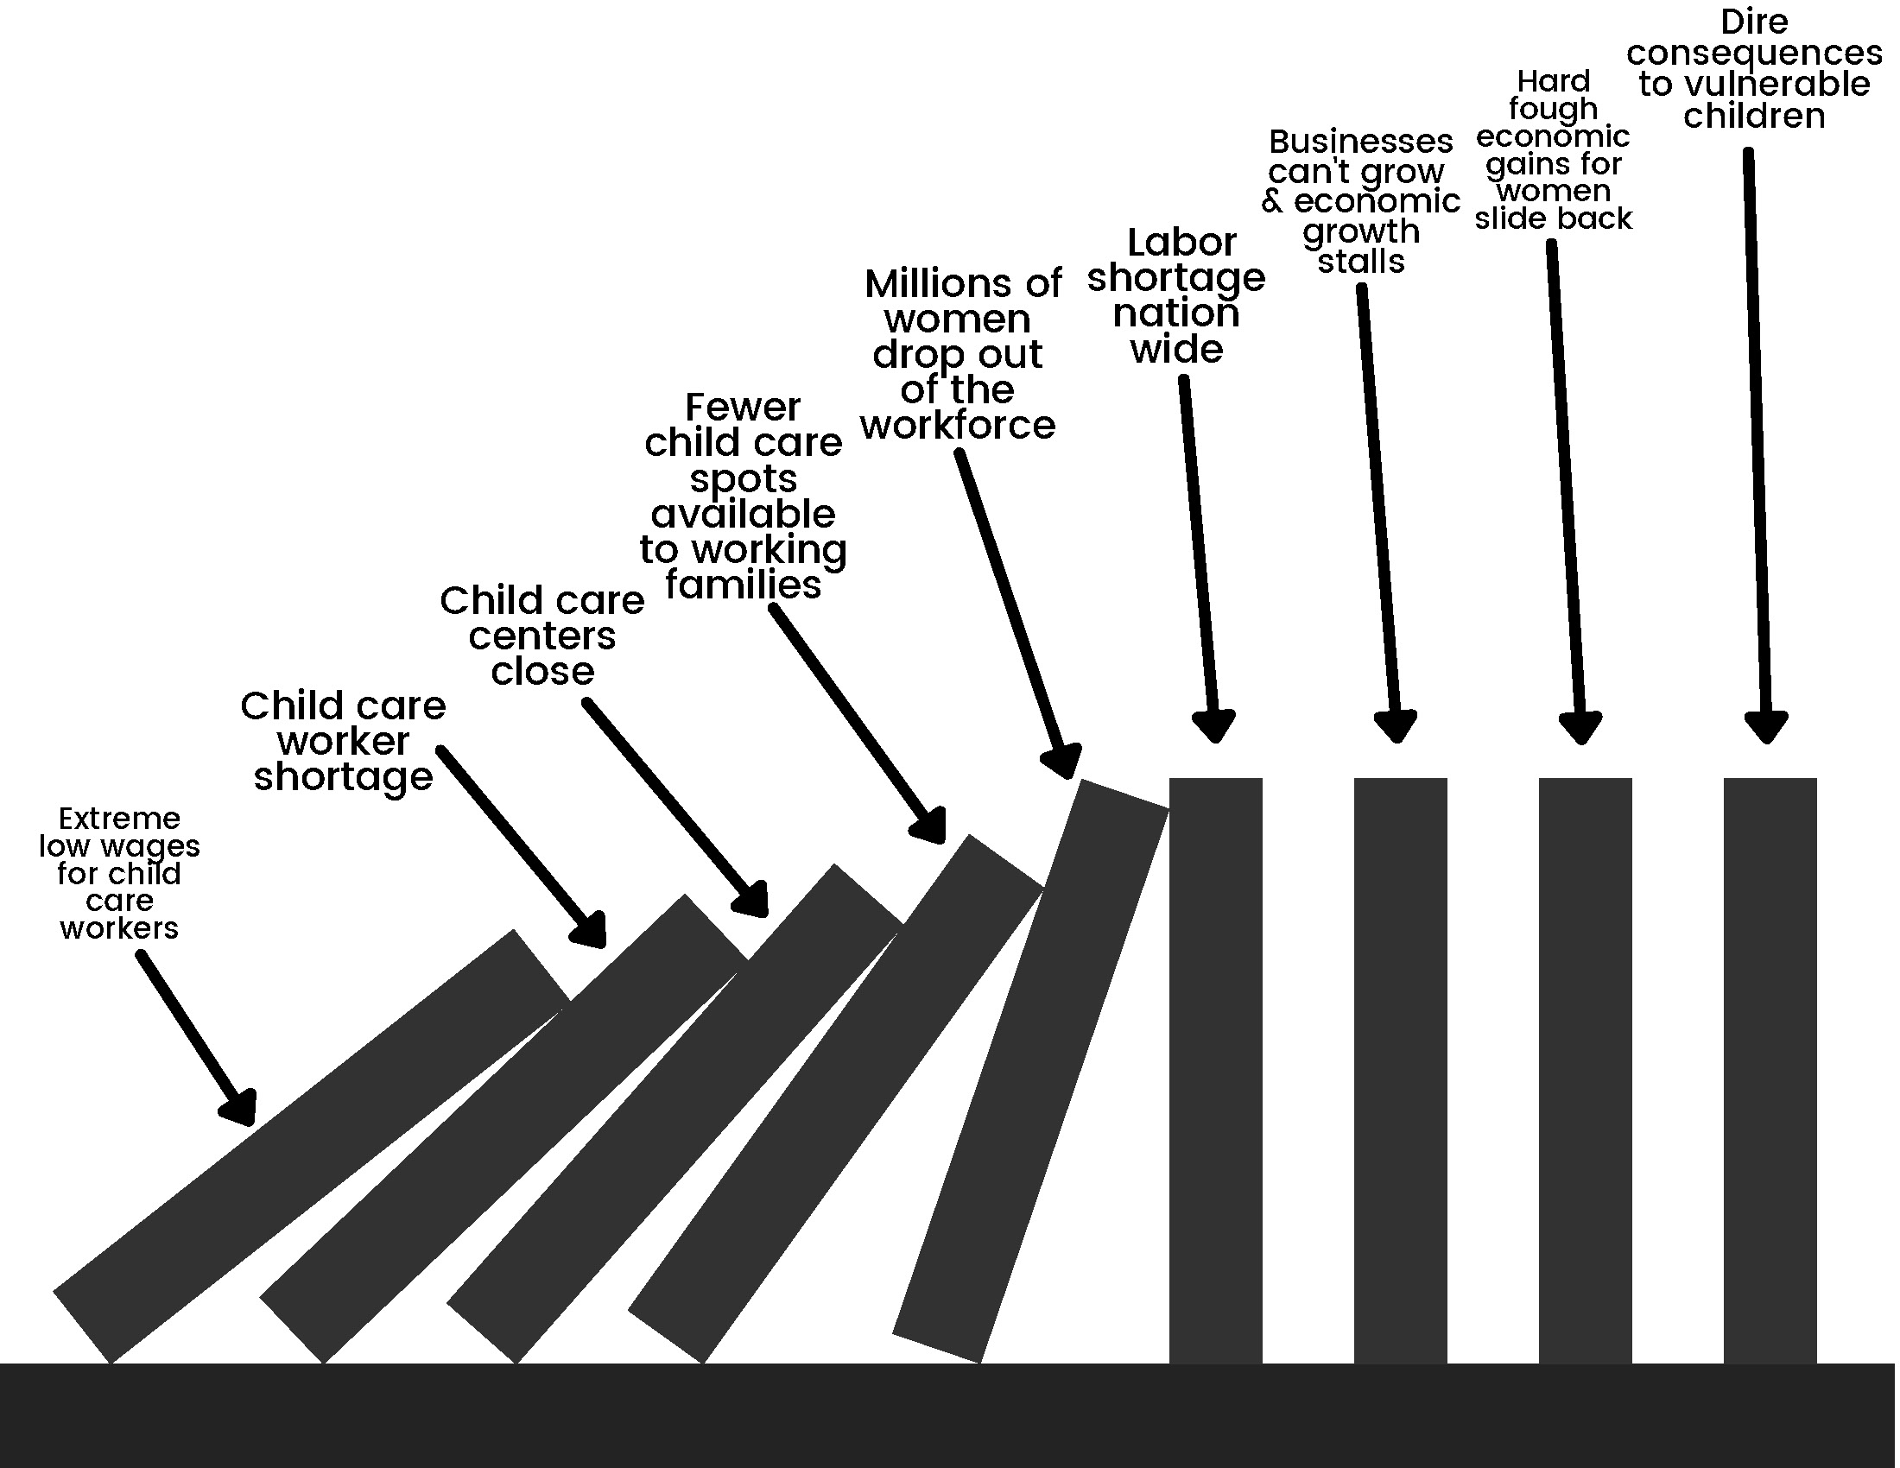
Child care data

Slide 4
Why this matters to businesses
National data suggests that unstable child care, and lack of access to quality child care costs businesses $3 Billion annually in lost production
Prior to the pandemic Upstate New York parents reported that when faced with a child care crisis they:
  40% call out of work
  38% leave early
  32% arrive late to work
  26% feel distracted at work
  19% cut back on work hours
  14% feel unproductive at work
We are currently facing the largest worker shortage in recent memory. Child care issues have been cited as one reason people are unable to return to work.

Slide 5
Why this matters to businesses
In a recent study conducted of Erie County parents, 52% of parents reported missing 1-4 days of work a month due to child care issues.
90% of respondents believed that business should care if their employees were able to secure child care.
In the same study only 29% of parents reported that their employer offered any family friendly benefits.
  Those benefits included:
    Flexible scheduling (74%)
    Babies at work/ bring your child to work (21%)
    On-site child care (31%)
    Child care stipend / reimbursement program / scholarship program (21%)
    Help finding child care (7%)

Slide 6
How lack of child care effects businesses?
Child-care industry for years has been escalating into a crisis.
Child care is a textbook example of a broken market.
Families are spending on average of 13% of their income on child care for young children.
Child care workers earn so little pay that they rank in the bottom 2% of all professions.
Pandemic –fueled staffing challenges threated to hold back the recovery, as the staffing problems at day cares have a ripple effect across the economy.
Without enough employees, day cares are turning away children, leaving parents, especially mothers, unable to return to work. Parents are looking for child care, but now it’s this catch-22. Child care programs do not have the staff, so they can’t open classrooms so families can go back to work because they can’t find child care.
Nearly 1.6 million moms of children under 17 are still missing from the labor force.

Slide 7
How lack of child care effects businesses?
When the pandemic first hit, women took the bulk of the professional blow.
With schools and day care closed, and so many stuck inside for remote work and remote school, the workforce hemorrhaged women.
A generation of burned-out women pulling away from paid work is a danger to women.
Women will take the lifelong income hit even if they do return to work.
Women are at risk of failing into financial crisis.
Income losses that result affect the rest of women’s lives, including their ability to save for retirement and their future social security benefits.
Women dropping out of the workforce hurts other working women.

Slide 8
How lack of child care effects businesses?
The numbers are staggering: the child care services industry is down 126,700 workers cited from the Department of Labor 2021.
More than a third of child care providers are considering leaving the business or closing down their business due to a sense of hopelessness according to the National Associate for the Education of Young Children.
Over half minority-owned centers are in danger of shutting.

Slide 9
Child care model
The reason child care centers pay less than service sector jobs is tied to the current business model.
Staffing costs are by far the biggest budget item. Regulation mandates one caregiver per 3 – 5 children, depending on their ages.
A study conducted during the pandemic by Philip Sirinides, director of the Institute of State and Reginal Affairs at Penn State Harrisburg, found labor costs account for 80% of a child care programs budget.
Raising pay for workers typically requires hiking fees for parents.
Child care providers have very narrow margins and they have to be at full capacity.

Slide 10
What CCRN does to help
Child Care Resource Network (Formerly Child Care Coalition of the Niagara Frontier) works with parents, providers, business leaders and legislators to help promote quality, affordable, accessible care and learning for all.
We do this by:
  Offering free child care referrals to parents. We provide parents with lists of licensed/registered child care programs near their home or office that meets their individual families needs
  Helping parents to create their child care plan, and navigate the child care subsidy system
  Working to attract more people to join the field of Early Childhood Education, or open their own programs. Thus increasing the supply of child care in WNY
  Offering continuing education to child care providers so they are providing the best possible care
  Creating and implementing Quality Improvement Projects with existing child care programs to increase the amount of quality child care in our area
  Managing the Child and Adult Care Food Program (CACFP) to reimburse child care providers who serve healthy meals and snacks to the children they care for
  Conduct regular licensing & monitoring visits to child care programs to ensure they are adhering to NYS’s rigorous health and safety standards

Slide 11
What can business do to help?
Adopt a family friendly working environment
  Babies at work programs
  Flexible work hours
  Work from home options
  On site child care programs – where appropriate
Provide child care referral resources at time of hire
Brief current employees about child care related resources available to them
Provide payment assistance to employees to help offset some or all child care expenses.
Partner with child care programs close to your place of work who can offer openings to your employees children, or potential discounts.
Partner with and invest in community based organizations that work to increase the supply of high quality child care.

Slide 12
Find child care
Across the state there are a network of Child Care Resource and Referral Agencies (CCR&R’s). They are charged with providing services to child care providers AND helping parents find licensed, registered, or permitted child care in their area.
There are 34 CCR&R’s in New York State find the one that serves your county by visiting: https://ocfs.ny.gov/programs/childcare/referral-agencies.php

